Slide 1
Adverse Drug Reaction Demographic Pipeline
A Framework for FDA-Approved Drugs, Clinical Trials, Adverse Events, and Census Data
Alex Balli — May 2026

Slide 2
Introduction
Professional background in chemical engineering and product development for adhesives and rubber-based products.
Had an internship early in my career working with a team of data scientists that wanted to use clustering to help justify material consolidation for Work in Progress inventory at a manufacturing company.
Since then, I leaned towards projects that involving machine learning and automation, leading me to data science and data engineering education through NSS.

Slide 3
Project Objectives
Early in my career, I had some interest in the pharmaceutical industry. For this project, I decided to combine
FDA approved drug information (Drugs@FDA)
Drug adverse event data (FAERS – FDA Adverse Event Report System)
Clinical trial data (ClinicalTrials.gov)
US Census data (census.gov)
This framework should help people to analyze:
Drug adverse event information
How adverse event demographics relate to the general population
What related drugs may need investigation
How to improve clinical trials in the future

Slide 4


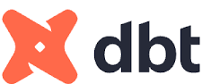





System Architecture
Orchestration with Airflow
Build staging and marts tables with dbt
API Calls and Raw Data Files
Snowflake
Database
Python Ingest with async and httpx
Upload to AWS S3 as Parquet
Python Load Database
Dashboard with Streamlit

Slide 5
Ingestion Pipeline Design
Ingestion of trial data from ClinicalTrials.gov with async API calls using httpx
Bulk json file ingestion of approved drug data from Drugs@FDA using httpx
FAERS quarterly file ingestion with async zip file downloads using httpx
Ingestion of census data with API calls using httpx

Slide 6
Data Modeling
BRONZE
Raw drug information, clinical trial data, adverse event data, and census data loaded into s3
SILVER
Raw tables were cleaned, data types were assigned, any necessary extra columns were created (i.e. age group aggregation), and json layers were flattened
GOLD
Final marts tables were created, tables were joined (i.e. by drug application number or drug generic or brand name), and important columns for analysis were chosen

Slide 7
Engineering Challenges
Blocked ingestion of FAERS and clinical trial data
Inconsistent structure across FAERS quarterly files
Drug name normalization across datasets
Large datasets – couldn’t process FAERS data all at once - 1 table had 80 million rows!

Slide 8
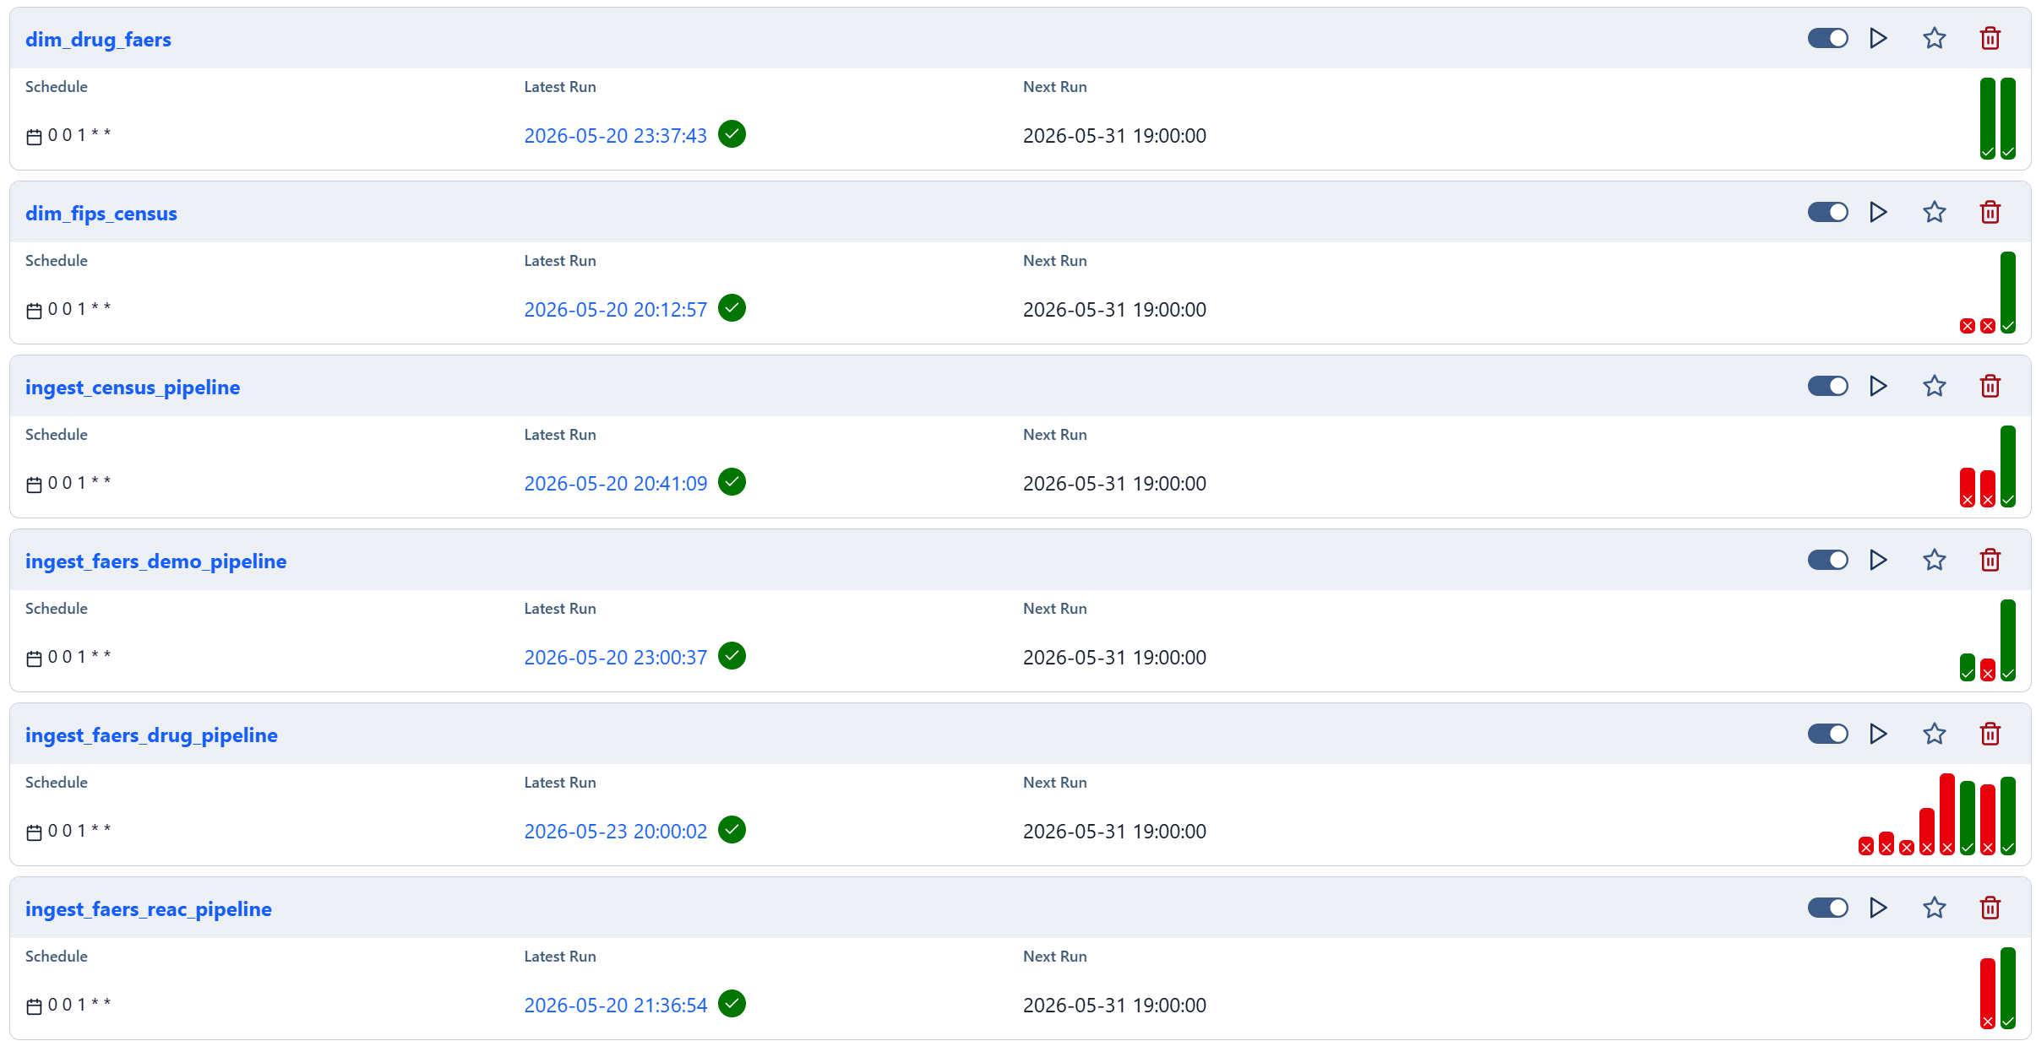
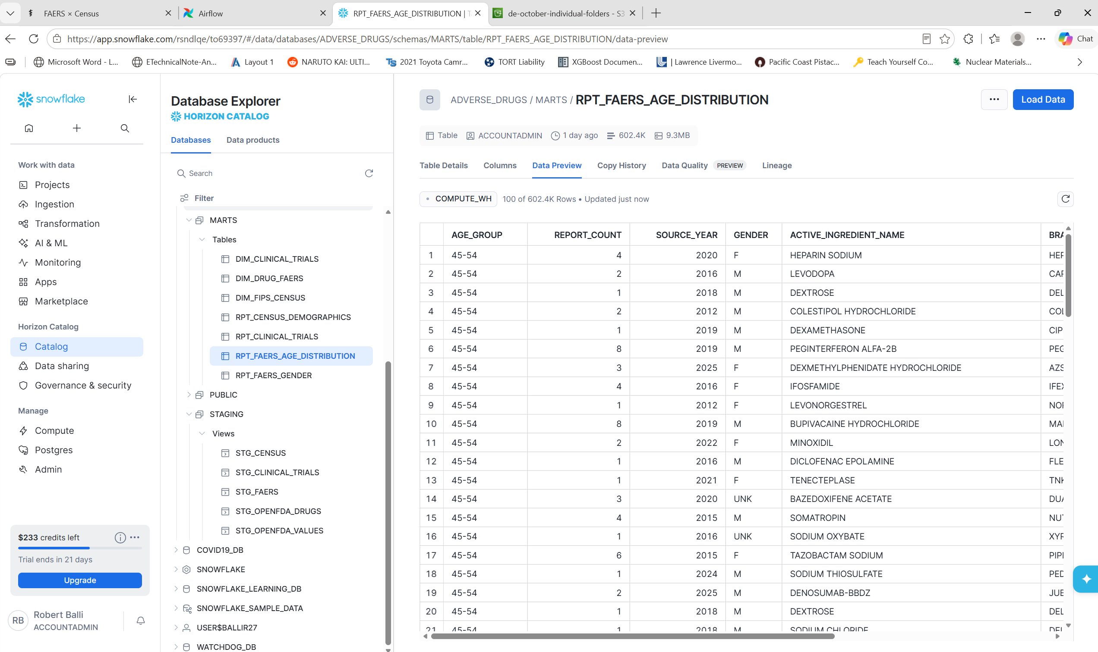
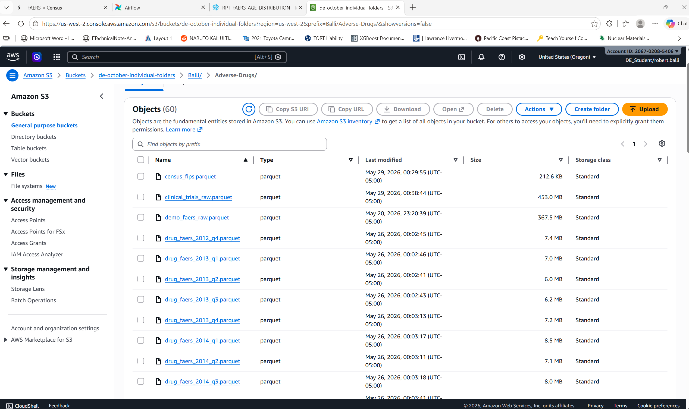
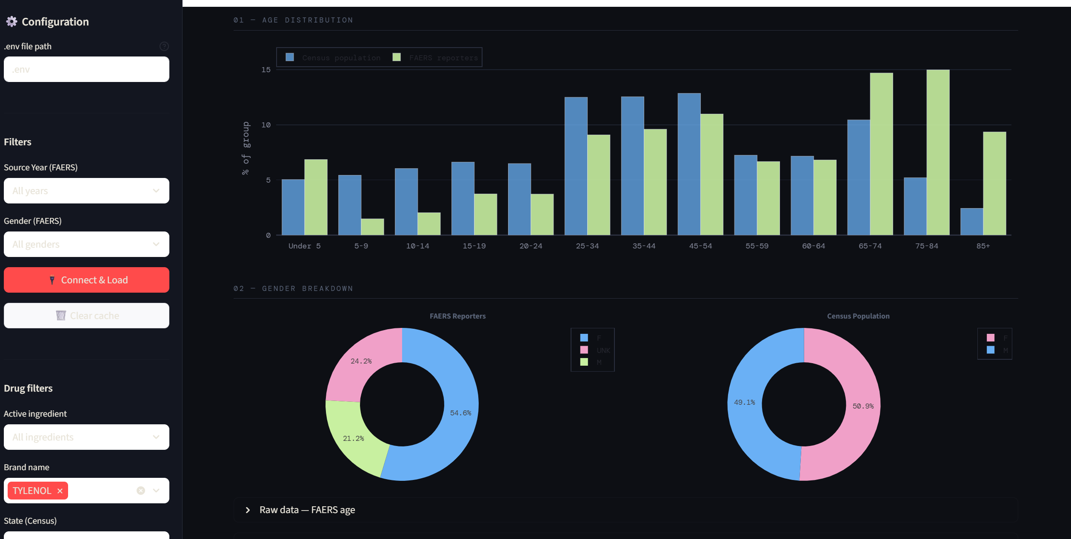
DEMO

Slide 9
Conclusions and Future Work
Successfully ingested and transformed data from Drugs@FDA, FAERS, ClinicalTrials.gov, and the US Census API
Successfully created orchestration with Airflow for this ingestion and transformation
Created a dashboard that summarizes the data from these sources
Next Steps:
Further cleaning of FAERS and trial data (cleaning and filter by drug type)
1
Use of Census International Database – FAERS and trial data is not just in the U.S.
2
Try new tools! Interested in re-building with databricks and prefect or dagster. Also interested in adding FastAPI.
3

Slide 10


Questions?

